Slide 1

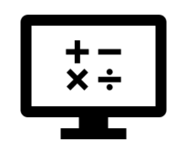
Beyond Introduction to Programming
Where do I find MATLAB? Here!
Do I have to have MATLAB installed on my computer right now? No, you can use MATLAB Online!

Slide 2

Table of Contents
Recap of Week 6, Part 2: Interoperability
Beyond the Introduction to Programming
Symbolic Math
Object-Oriented Programming (OOP)
Simulink
What we've covered this week in part 3: Beyond Introduction to Programming
Extra resources
References
MATLAB Live Script

Slide 3
Recap of Week 6, Part 2: Interoperability
This week in part 2, we learnt about:
Interoperability with other languages
MATLAB and Python
In the next part of this week's content, we will be demonstrating Beyond Introduction to Programming, covering the following sub-topics:
Symbolic Math
Object-Oriented Programming (OOP)
SimulinkMATLAB and Python

Slide 4
Beyond the Introduction to Programming
In this course, we only scrapped the surface of the programming you will likely encounter in the future. It was built with the intention to supply you with a good starting point, and to show you that you too can be programmer. This last section is dedicated to introducing you three other approaches to programming that you may encounter some time in your future.

Slide 5
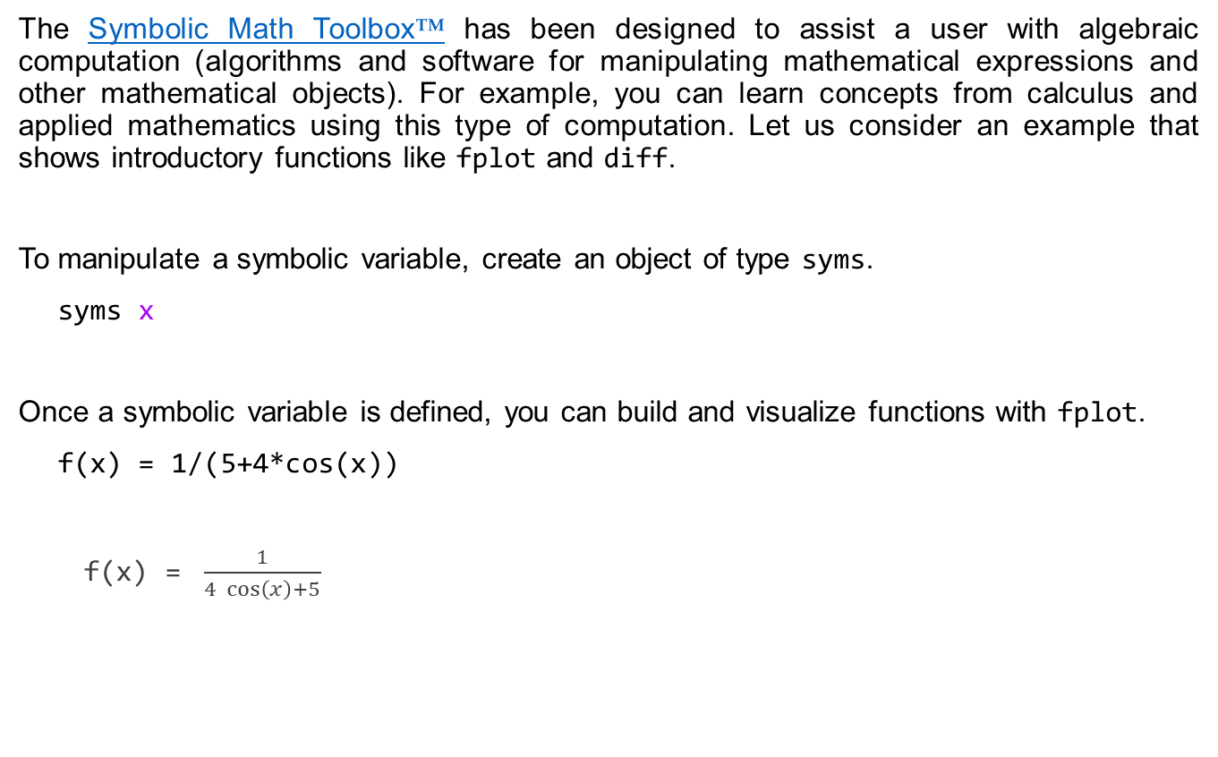
Symbolic Math
The Symbolic Math Toolbox™ has been designed to assist a user with algebraic computation (algorithms and software for manipulating mathematical expressions and other mathematical objects). For example, you can learn concepts from calculus and applied mathematics using this type of computation. Let us consider an example that shows introductory functions like fplot and diff.
To manipulate a symbolic variable, create an object of type syms.
syms x
Once a symbolic variable is defined, you can build and visualize functions with fplot.
f(x) = 1/(5+4*cos(x))
f(x) = $\frac{1}{4 \cos\left(x\right)+5}$

Slide 6
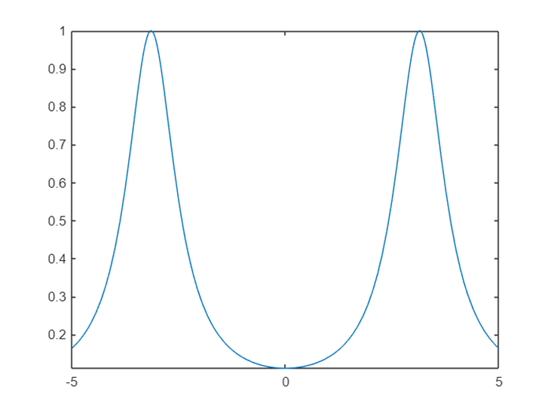
Symbolic Math
fplot(f)

Slide 7
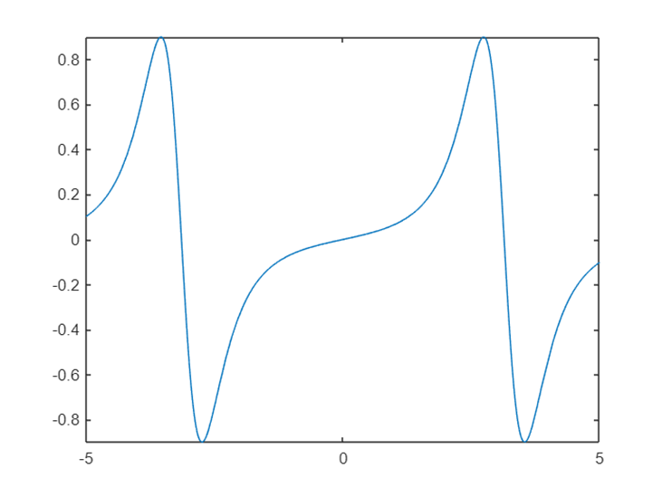

Symbolic Math
Many functions can work with symbolic variables. For example, diff differentiates a function.
f1 = diff(f)
f1(x) = $\frac{4 \sin\left(x\right)}{{\left(4 \cos\left(x\right)+5\right)}^{2}}$
fplot(f1)

Slide 8

Symbolic Math
The above is just one example of how algebraic computation can be leveraged, so I encourage you to visit the Getting started with the Symbolic Math Toolbox for more ideas on how this approach can assist your workflow.
Now you try! Use the fplot function to create a plot of sin(x), cos(x), and tan(x) on the same set of simultaneously.
Hint: Combine the three trigonometric functions in an array and remember to define x as a symbolic variable.

Slide 9
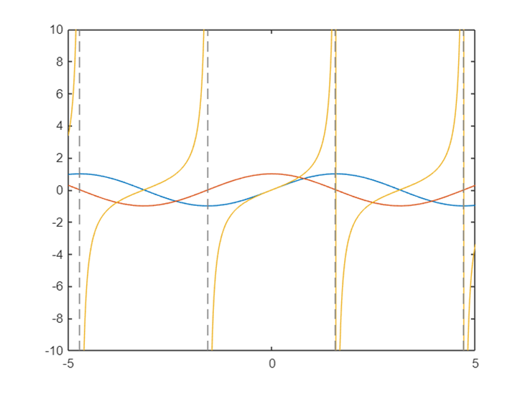
Symbolic Math
syms x
fplot([sin(x),cos(x),tan(x)])

Slide 10
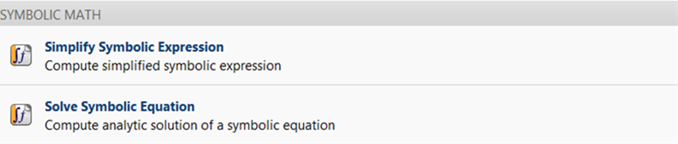
Symbolic Math
Another way to leverage symbolic math in your workflow is to use the Symbolic Math Live Tasks. You can find these by selecting the Insert tab in your Toolstrip when working in a Live Script, and selecting the task you would like to perform.
The following Live Tasks are currently available when you have the Symbolic Math Toolbox installed:

Slide 11
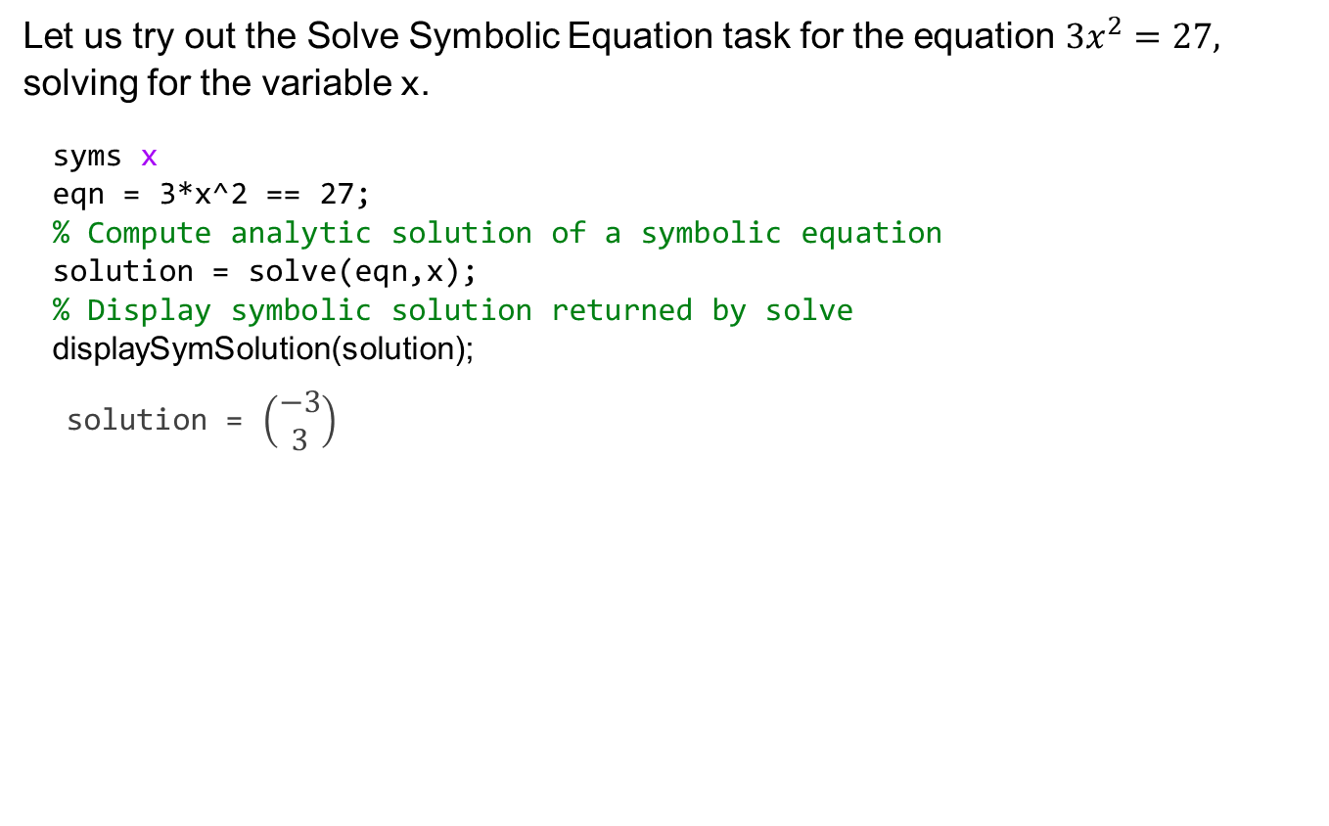
Symbolic Math
Let us try out the Solve Symbolic Equation task for the equation ${3x}^{2}=27,$ solving for the variable x.
syms x
eqn = 3*x^2 == 27;
% Compute analytic solution of a symbolic equation
solution = solve(eqn,x);
% Display symbolic solution returned by solve
displaySymSolution(solution);
solution = $\left(\begin{matrix}−3 \\ 3\end{matrix}\right)$

Slide 12
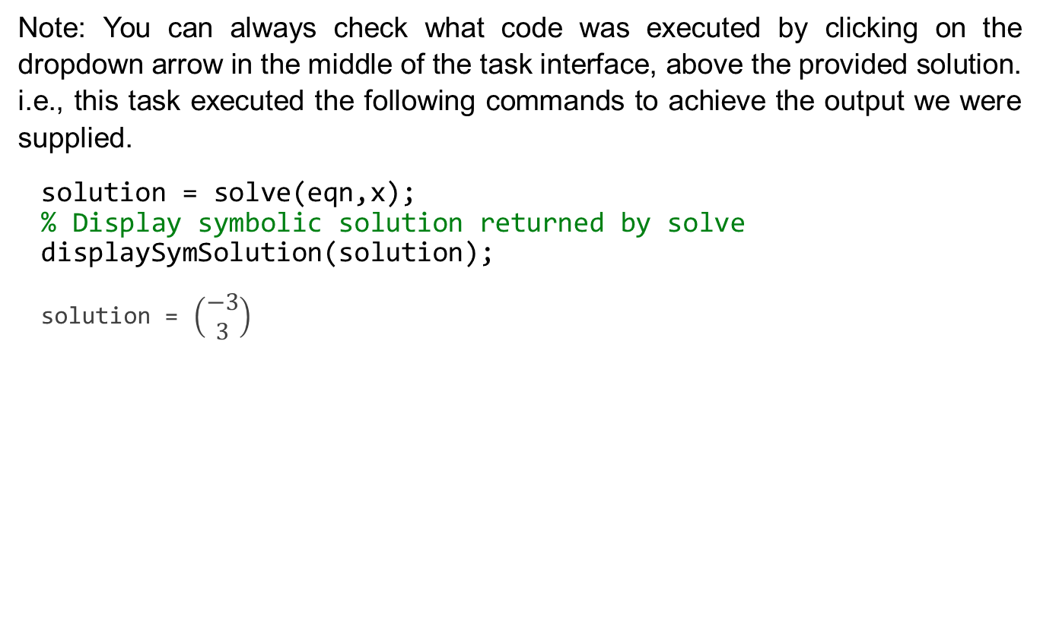
Symbolic Math
Note: You can always check what code was executed by clicking on the dropdown arrow in the middle of the task interface, above the provided solution. i.e., this task executed the following commands to achieve the output we were supplied.
solution = solve(eqn,x);
% Display symbolic solution returned by solve
displaySymSolution(solution);
solution = $\left(\begin{matrix}−3 \\ 3\end{matrix}\right)$

Slide 13
Object-Oriented Programming (OOP)
Object-oriented programming is a design approach that enables you to programmatically define structures called objects that combine data (properties) together with functions that operate on that data (methods). In MATLAB, you can create objects that model the behaviour of devices and systems in the real world. Those objects can then be used as building blocks in applications used to simulate and analyse complex systems.
A Class in MATLAB follows a particular convention that needs to be followed when creating your own Class. A quick and convenient way for creating a new class is to autogenerate a Class template by navigating to the Home tab in the Toolstrip, selecting New, and then either a Class, Test Class, and System Object depending on your needs. This workflow is illustrated in the following graphic.

Slide 14
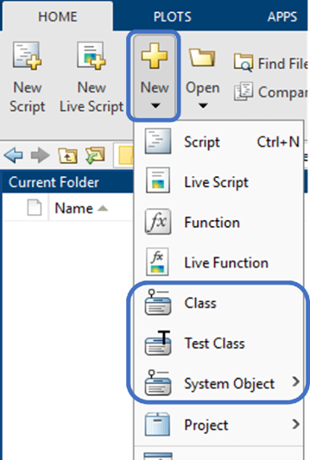
Object-Oriented Programming (OOP)
This workflow is illustrated in the following graphic.

Slide 15
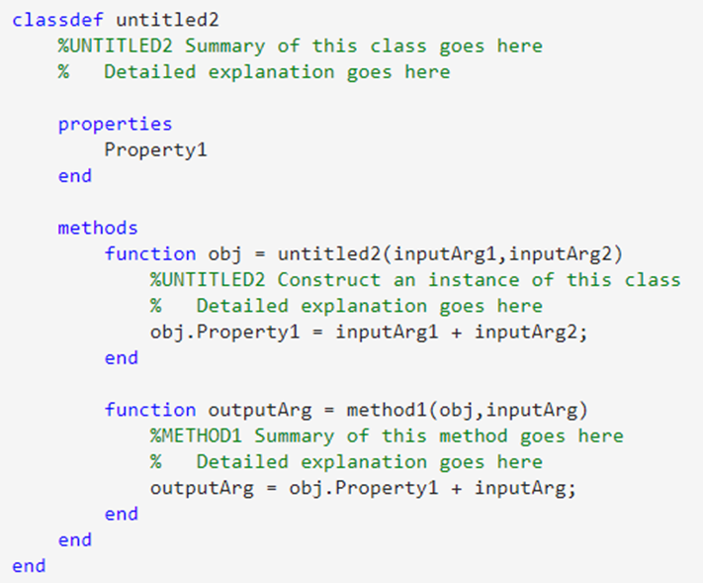
Object-Oriented Programming (OOP)
Let us follow the workflow when a Class template has been selected. The following template is supplied in a new script file:
Notice that each section has been labelled and a description has been given in green (following a single %). A class can be broken up into two sections; properties, and methods.

Slide 16
Object-Oriented Programming (OOP)
These can be thought of in the following manner:
Properties are nouns
Methods are verbs

Slide 17
Object-Oriented Programming (OOP)
Object-Oriented Programming offers the following four major benefits over procedural and functional programming methods:
Abstraction - Simplify your program by using classes that generalise the object types
Encapsulation - Being able to define a scope for a particular object prevents the user of the object from becoming dependent on an implementation details or characteristic (risk of changing or breaking the code)
Inheritance - Classes can inherit from one another, allowing you to reuse more of your code
Polymorphism - A single class can be used to create multiple objects with ease and flexibility
For a basic example of OOP in MATLAB, please consult this Technical Article: Introduction to Object-Oriented Programming in MATLAB, where tuart McGarrity and Adam Sifounakis cover the OOP workflow development for analysing sensor array data.

Slide 18
Simulink
Simulink is a block diagram environment used to design systems with multidomain models, simulate before moving to hardware, and deploy without writing code. It allows for us to visualise an intuitive approach for modelling equations and systems. It forms a foundation for Model-Based Design, including multidomain system modelling, real-time testing, automatic code generation, and verification and validation.
To demonstrate how simple this block diagram environment can be leveraged in your workflow, let us consider the implementation of an equation model that converts a temperature in degrees Celsius to degrees Fahrenheit.

Slide 19
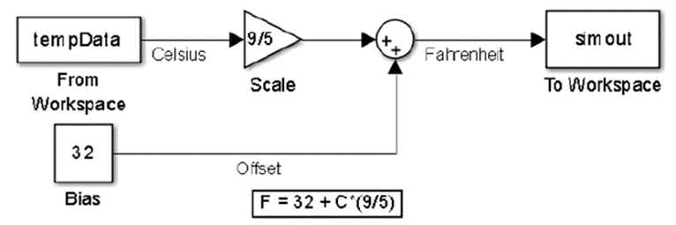

Simulink
The equation for this conversion is
$${}_{}^{o}F=32+{}_{}^{o}C(9/5)$$
and the Simulink implementation of this has been screenshot in the following image.

Slide 20
Simulink
Watch this short video for the Simulink overview, and if you want to know more about deployment to hardware, then take a look at the following links:
Getting Started with Arduino Hardware
Run Model on Arduino Hardware
MathWorks Minidrone Competitions Page
Vehicle Modeling Using Simulink
Deploying a Deep Learning-Based State-of-Charge (SoC) Estimation Algorithm to NXP S32K3 Microcontrollers

Slide 21
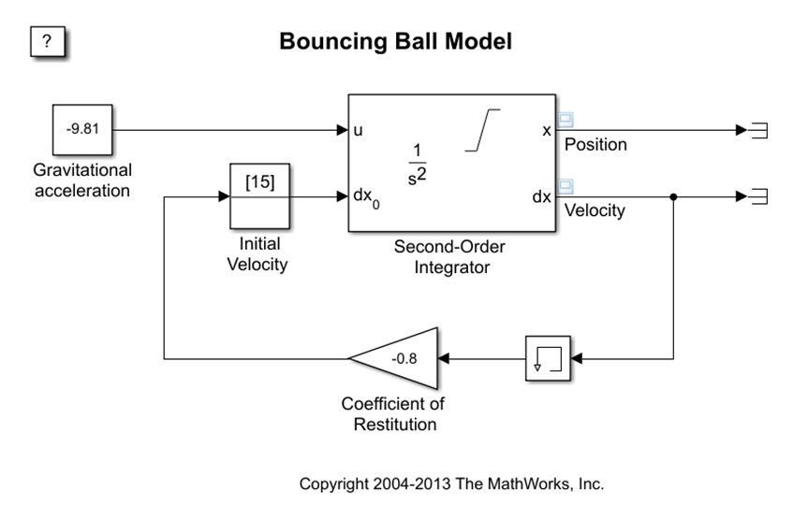
Simulink
As an example, let us consider a bouncing ball example. You can access this by running the following code cell:
openExample('simulink_general/sldemo_bounceExample’)
A Simulink model will open with the following configuration:
The model itself was built on the equations of motion given some initial conditions. This type of example could have been done in MATLAB too, but this approach was to show you how easy and intuitive the design of a solution can be executed in the Simulink environment.

Slide 22
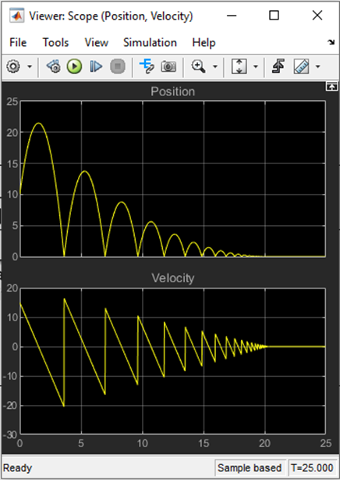
Simulink
Click on the Run button, and viewer window will pop up showing the position and velocity of the ball at different points in time in the simulation.

Slide 23
What we've covered this week in part 3: Beyond Introduction to Programming
This week in part 3, we learnt about:
Interoperability with other languages
MATLAB and Python
In the next part of this week's content, we will be demonstrating Beyond Introduction to Programming, covering the following sub-topics:
Symbolic Math
Object-Oriented Programming (OOP)
Simulink

Slide 24
Extra resources
Documentation example: Create Symbolic Matrix Variables
Video tutorial: Developing Classes Overview
Documentation: OOP Property Attributes
Documentation: OOP Method Attributes
Documentation: OOP Validate Property Values
Documentation: Create a simple model using Simulink
Video: IoT from Data to Action, Part 1: Getting started with ThingSpeak
Simulink Onramp self-paced course
Simulink Fundamentals self-paced course
Machine Learning with MATLAB
Deep Learning with MATLAB
Self-Paced Online Courses

Slide 25
References
Getting started with Symbolic Math Toolbox
Learn Calculus in the Live Editor
Object-Oriented Programming in MATLAB
Technical Article: Introduction to Object-Oriented Programming in MATLAB
Product page: Simulink
Virtual lab: Air-track collisions
Documentation: Simulation of a bouncing ball

Slide 26
MATLAB Live Script
Click on the link below for this lecture’s MATLAB live Script
Week_6_Part_3_Beyond_Introduction_to_Programming_Solution.mlx
Copyright 2022 The MathWorks, Inc. & Opti-Num Solutions (Pty) Ltd.

